Slide 1

Tablet Menu Survey Results

Slide 2
Summary
Tablet Menu Launch
Bar Sections of Locations
Adoption of New System and Software
Notes:
The rollout phase puts together all the work done thus far in the project and allows us to launch and survey the launch for its success and effectiveness. Sauce and Spoon implemented the table top tablet menu in the bar sections of its locations to increase certain predefined metrics

Slide 3

Measurements
Goals
Increase guest counts by 10%
Reduce food waste by 25%
Reduce table turn time by 30 minutes
Increase appetizer sales by 15%
Increase average check size by 15%
Increase customer satisfaction to 98%
Notes:
These are the goals or metrics our stakeholders are hoping to achieve with this rollout. With the metrics we hope to add to overall customer experience and increase customer satisfaction

Slide 4
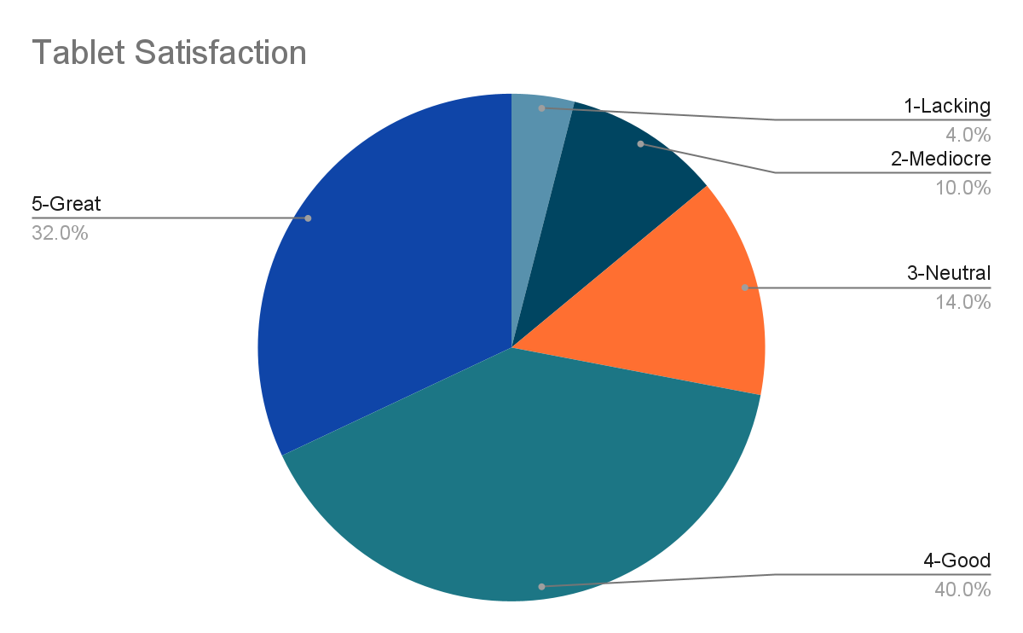
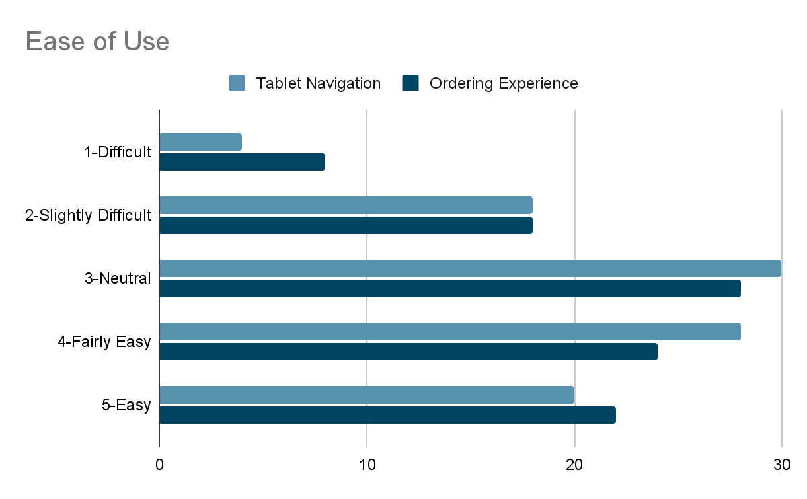
Tablet Menu Data
Notes:
Overall the tablets have received positive feedback from 52% of the quest that used them. Similar percentages of customers stated that they were easy to use and liked the design of the menu. The staff was very helpful in providing assistance and instructing the guests in how to operate the tablet menu. Conversely, some of the constructive feedback received for the tablet menu included the issue of freezing and also the added steps for cash paying customers. Overall, the tablet menu dining experience was positive.

Slide 5


Next Steps
Recommendation 1
Offer option for guests to choose: traditional service vs tablet service
Option at beginning of service
Cash payers
People who prefer traditional service
Notes:
To address some of the constructive feedback offered by guests, I would recommend these next steps before a full restaurant rollout.

Slide 6

Next Steps
Recommendation 2
Investigate and resolve freezing issue
Update software
Update hardware
Better Wifi
Quick tutorial for guests to optionally view

